Slide 1

FarmGenie (LocateLabs)
Team Members:
1) Swata Swayam Dash
2) Yuvraj Singh

Slide 2

PROBLEM
Farmers today face a constant battle to stay on
top of the latest advancements and best practices
in agriculture.
SOLUTION
FarmGenie is here to help.
This comprehensive online platform harnesses the power of large language models and conversational AI to put a wealth of agricultural knowledge right at farmers' fingertips.

Slide 3

BENEFITS
With FarmGenie, farmers can engage with an intuitive
AI-powered chatbot that taps into a vast database of
up-to-date information.
Whether you need guidance on crop management,
pest control, or market trends, the FarmGenie chatbot
can provide tailored, expert-level advice in real-time.
No more sifting through outdated resources or waiting for an agronomist to become available.
FarmGenie brings the knowledge you need directly to your fingertips, empowering you to make informed, data-driven decisions that optimize your operations. It's an agricultural assistant that works around the clock to help you stay ahead of the curve.

Slide 4



ABOUT THE PROJECT
DATA
MODEL
PRODUCT
The data used consists of openly available PDF/Books from various government and educational sites.
The text extracted from these Books and PDFs and used to fine-tune a SLM (Small Language Model) for a QnA Tasks as per of our framework.
Our conversational-AI framework consists of 3 major parts : MOE (Mixture of Experts Fine tune LLMs), Conversational Managing LLMs and Translation/RAG.
We aim to design a product (FarmGenie) which helps the way the farmers gain up to-date knowledge regarding various agricultural and farming practices from the Internet.
The product ensures they get the right knowledge through our devised advance conversational-AI framework, community forms and our interactive web interface

Slide 5
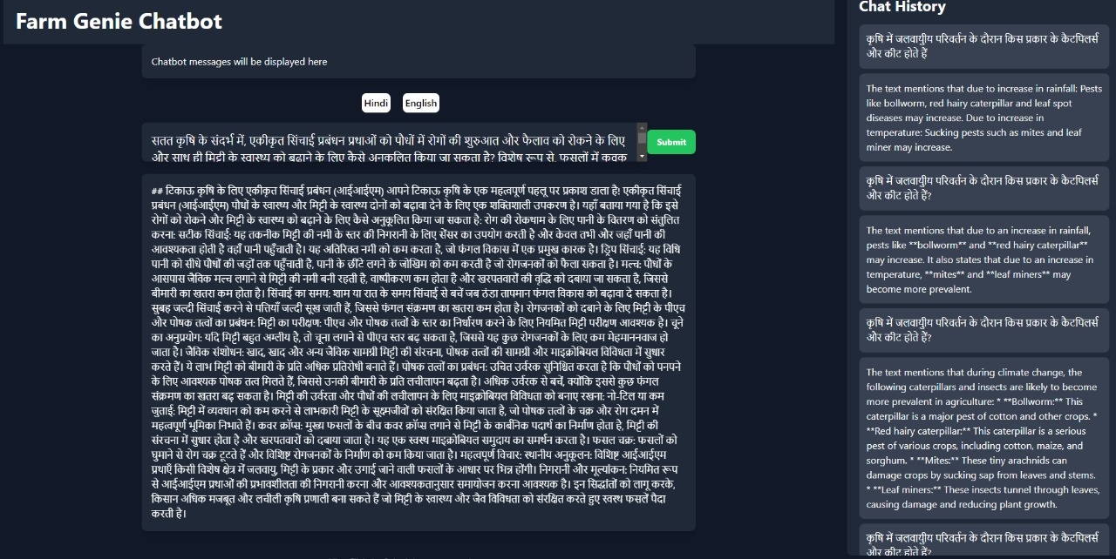
SneekPeek!

Slide 6
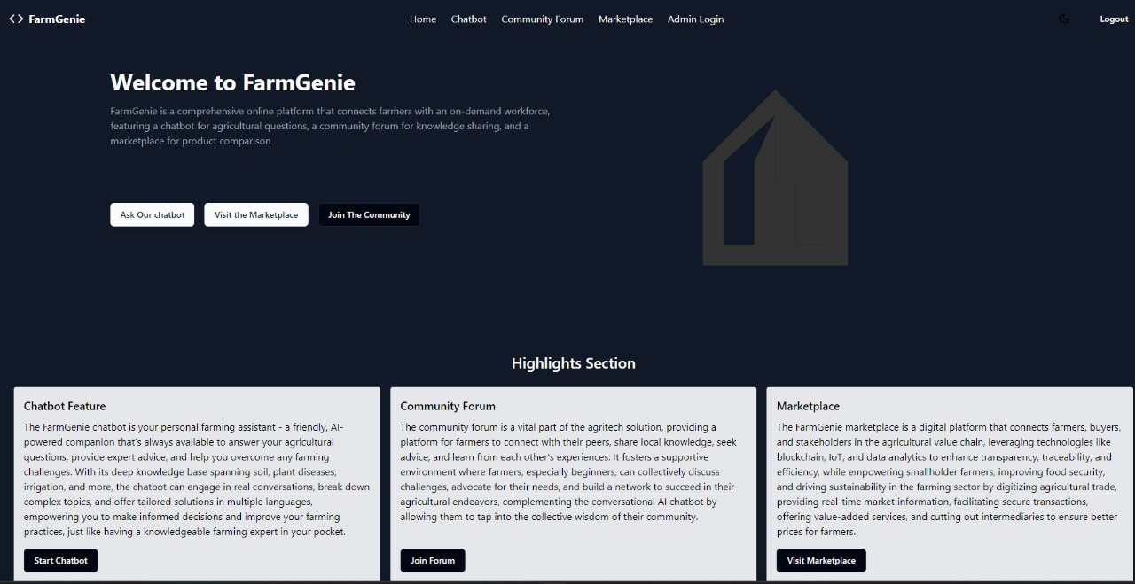
SneekPeek!

Slide 7



PRODUCT OVERVIEW
Website , Chatbot and Dual Marketplace
FarmGenie Community
Monitoring server

Slide 8
PRODUCT FEATURES OVERVIEW
WEBSITE
COMMUNITY FORUM
1.AI-powered Knowledge Base
2.Dual Marketplace:
i. Input Marketplace (for local sellers and dealers)
ii. Output Marketplace (for farmers)
1. Multilingual Support
2. Gamified help system
3. Communities

Slide 9
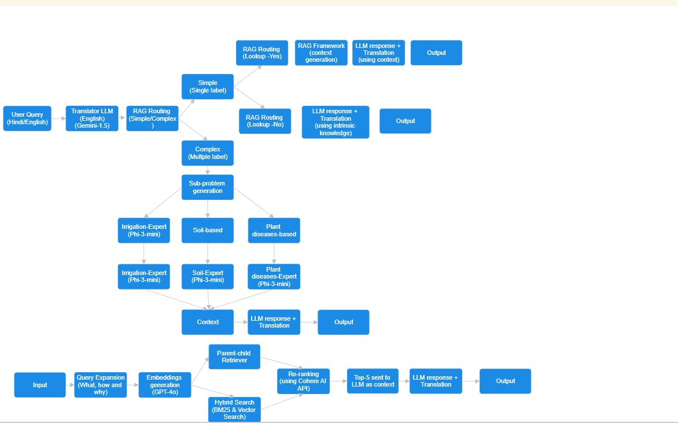
PRODUCT FEATURES OVERVIEW
CHATBOT

Slide 10
PRODUCT FEATURES OVERVIEW
SCALABILITY
1. Turborepo for Monorepo Management
i. Streamline development workflows
ii. Efficient code sharing
iii. Dependency management
iv. Atomic versioning across both the main website and community forum
2. Horizontal scaling architecture:
i. Redis Queue
ii. Worker nodes (where the ML model is deployed)
3. Monitoring & Security:
i. Prometheus (a powerful open-source monitoring system)
ii. Grafana (open-source software for real time visualization)
iii. NextAuth (for official website)
iv. Clerk (for community forum)

Slide 11
MAJOR CHALLENGES/DRAWBACKS
1
2
3
MoE is an extensive task when it comes to increasing the number of experts since it won’t be feasible without heavy compute and other resources.
Translation should be done with the help of Translation APIs like the ones offered by Google or Indic LLMs instead of hard prompting the LLMs to do so as it may lead to unexpected error on larges ones when into production(we are yet to test this).
We chose Gemini Pro because of its free tier services and appreciable translation abilities for our use-case.
A ML model should be more appropriate approach to train and use it for Simplex/Complex query segregation to have better control and usability.
However, hard prompting worked in our case.
- High quality dataset, especially access to quality PDFs/Books for generation of QnA pairs and RAG.
- Since we couldn’t find many open and big pdf on the same nor the QnA pairs we had to make use paid services like OpenAI APIs to create the pairs.

Slide 12
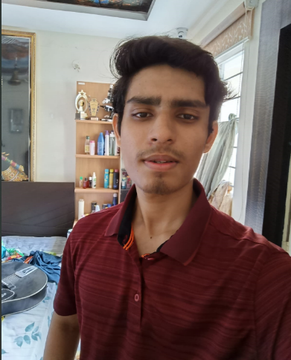
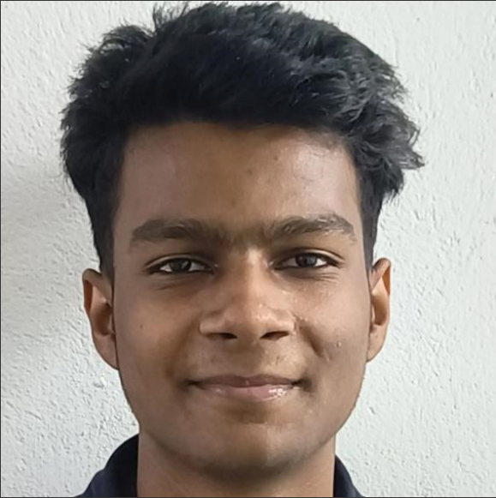
MEET THE FULL TEAM
SWATA SWAYAM DASH
YUVRAJ SINGH
Team Lead
Member

Slide 13
THANK YOU
Thank you for your interest in our product!
Our product (FarmGenie) aims to empower farmers, support sustainable agriculture, and drive positive change in the agricultural sector. We look forward to discussing how our solution can benefit your organization

